Slide 1
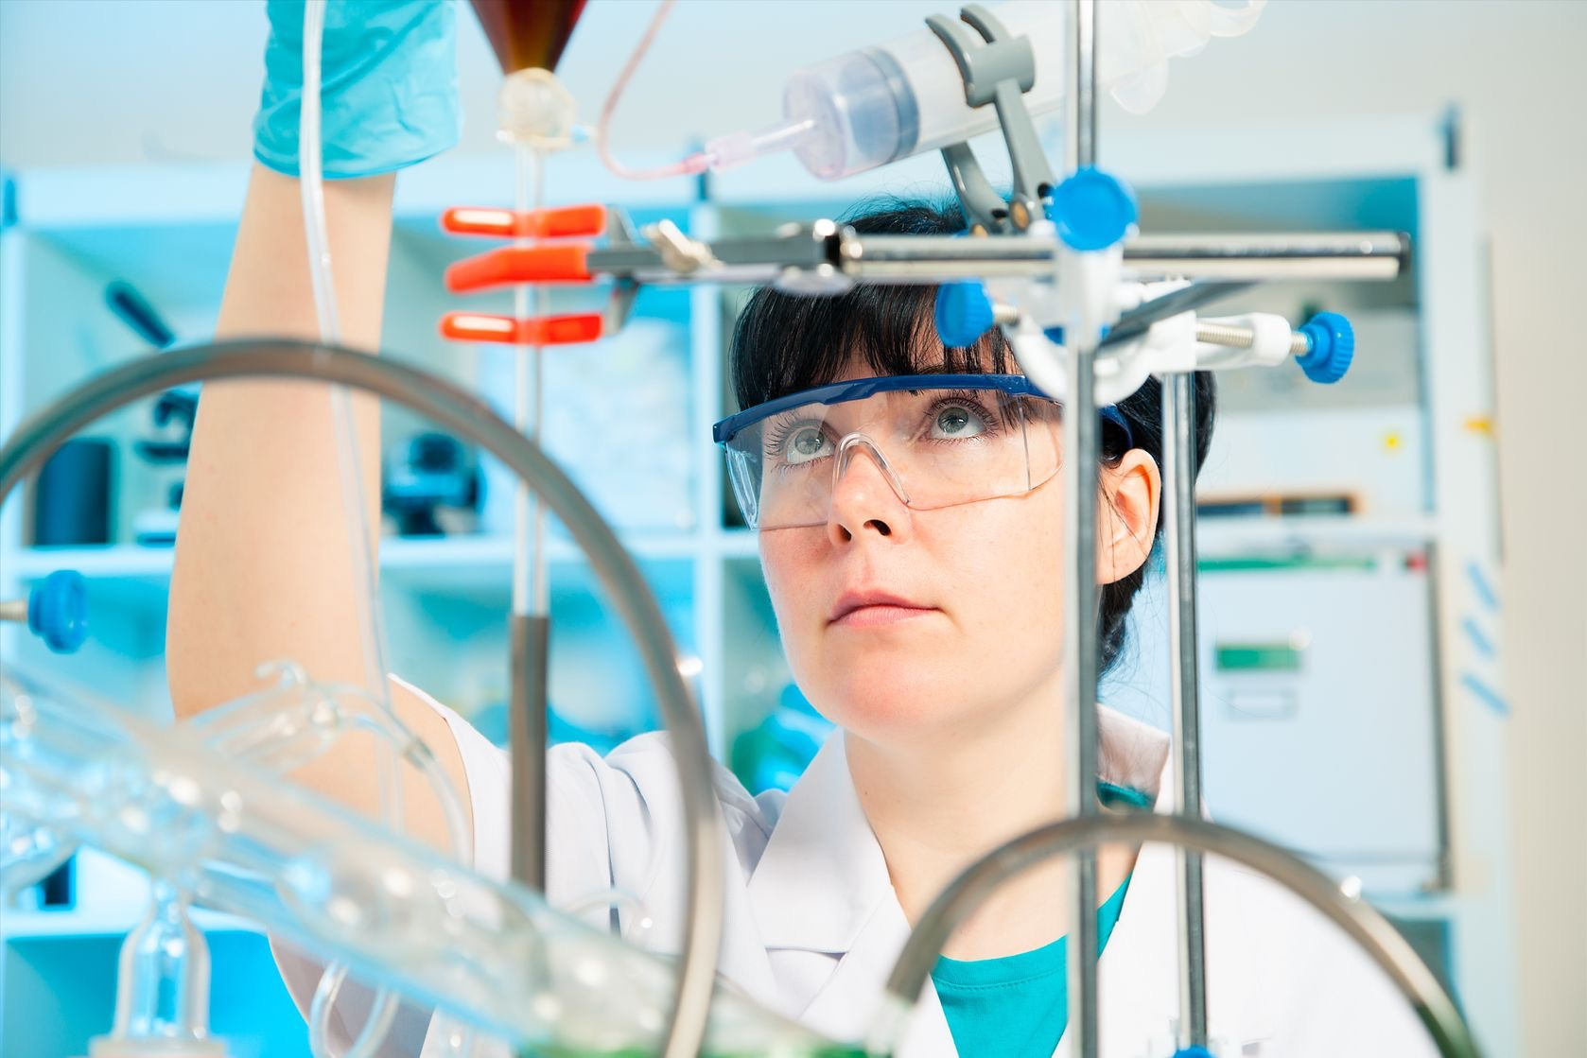
Chemical Change
Episode 1 Chemistry watch

Slide 2
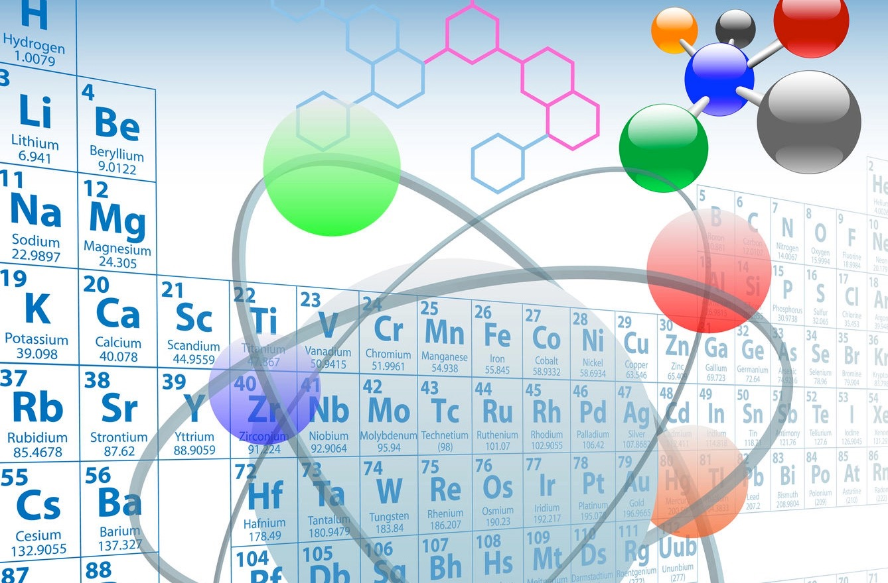
You will be able to:
distinguish chemical from physical change.
recognise evidence for a chemical change or reaction.
understand that chemical reactions release energy to the surroundings while other absorb energy.
know that oxygen is needed in oxidation reactions such as burning.
be aware of usefulness of chemical reactions in everyday life.
1.1

Slide 3
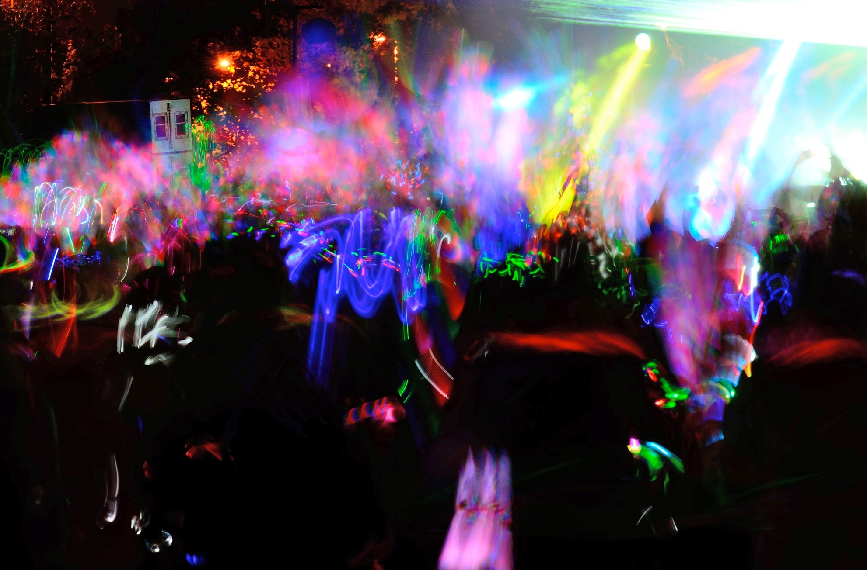
Is a chemical reaction taking place here?
1.2

Slide 4
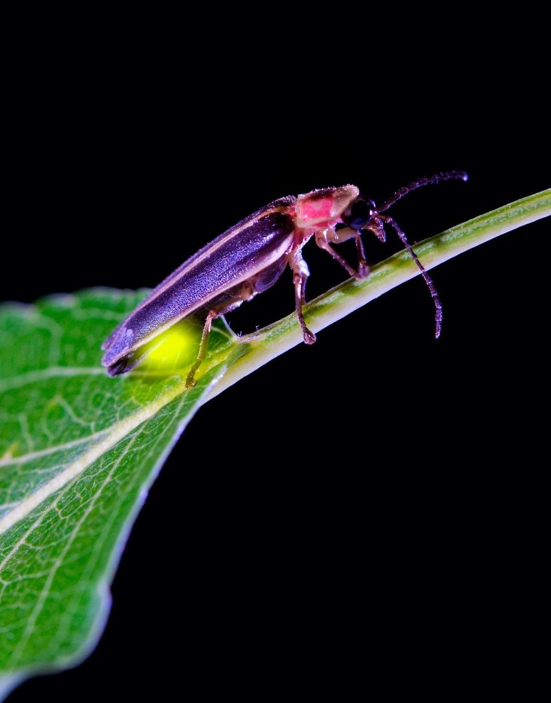
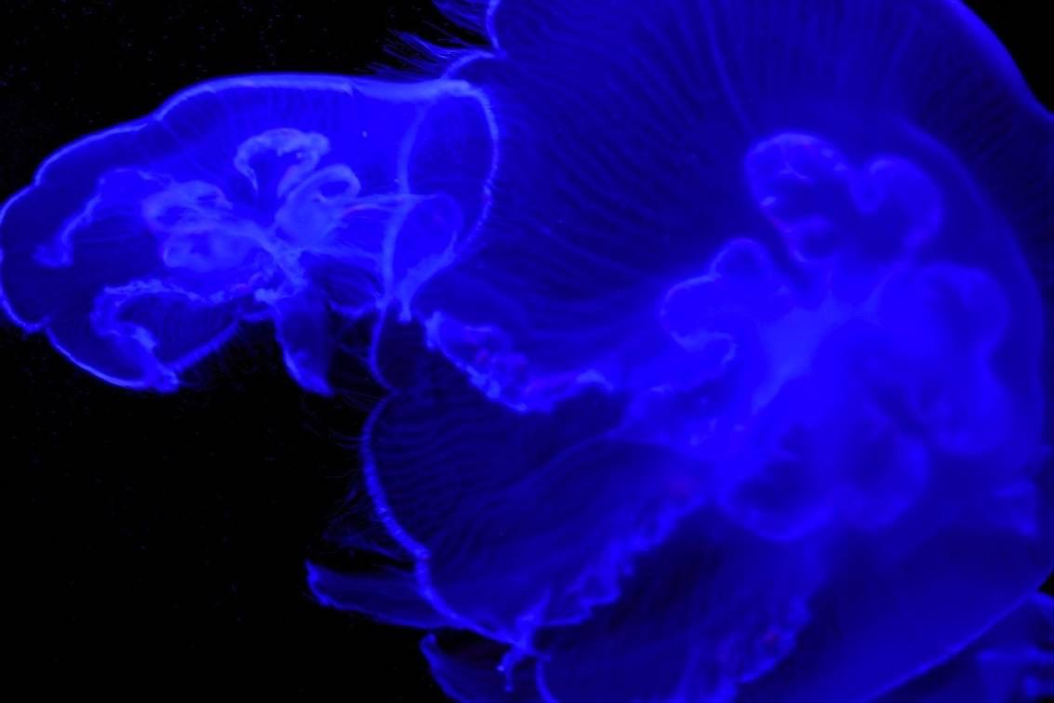
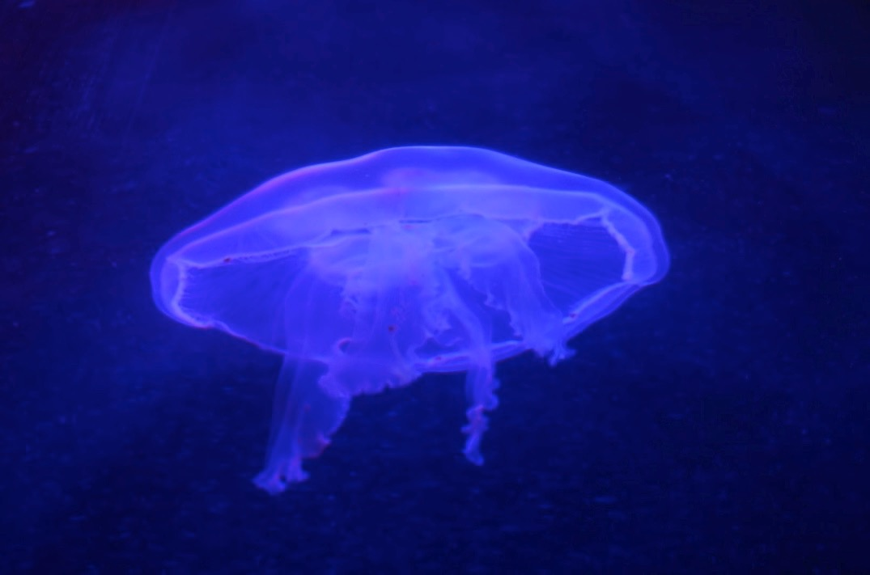
Look at the pictures and discuss these applications of chemiluminescence.

Slide 5
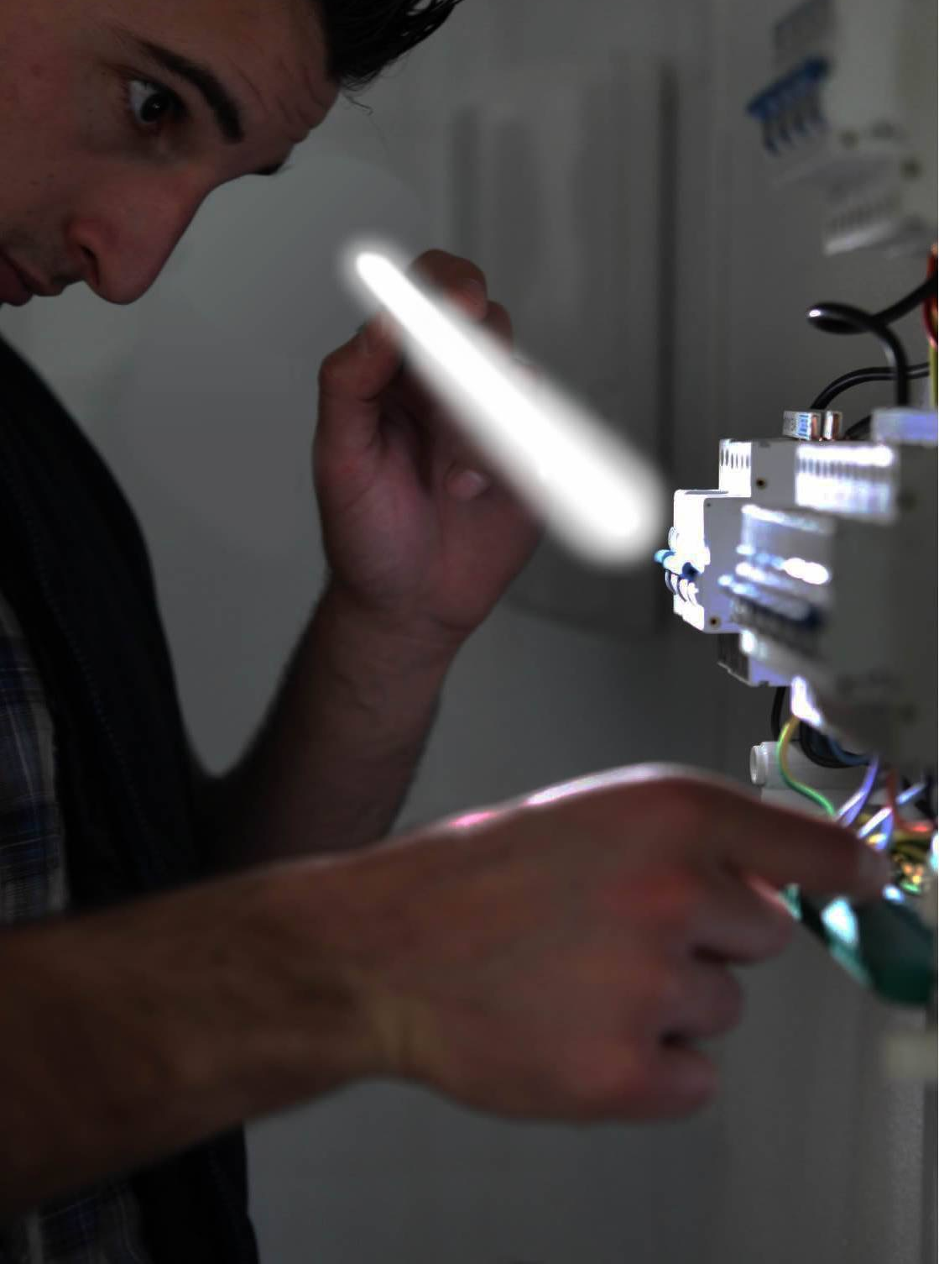
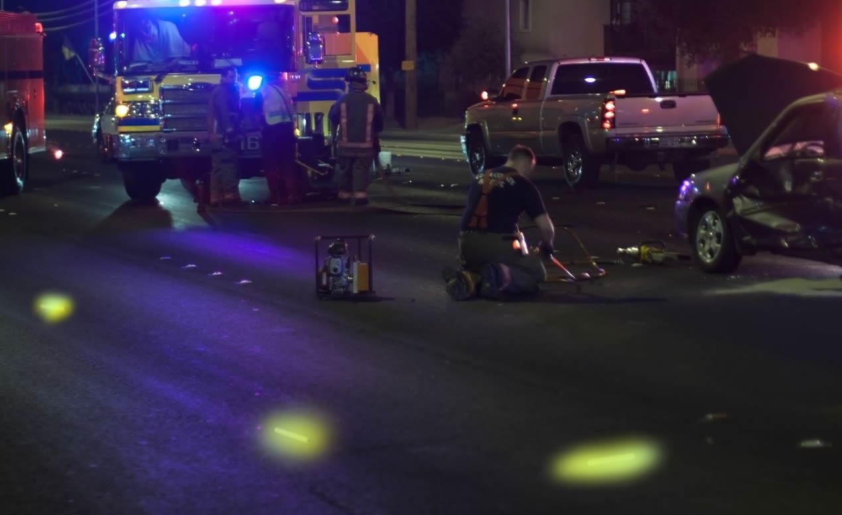
Do you think any heat energy is release in glowstick reactions?
Simulated images

Slide 6
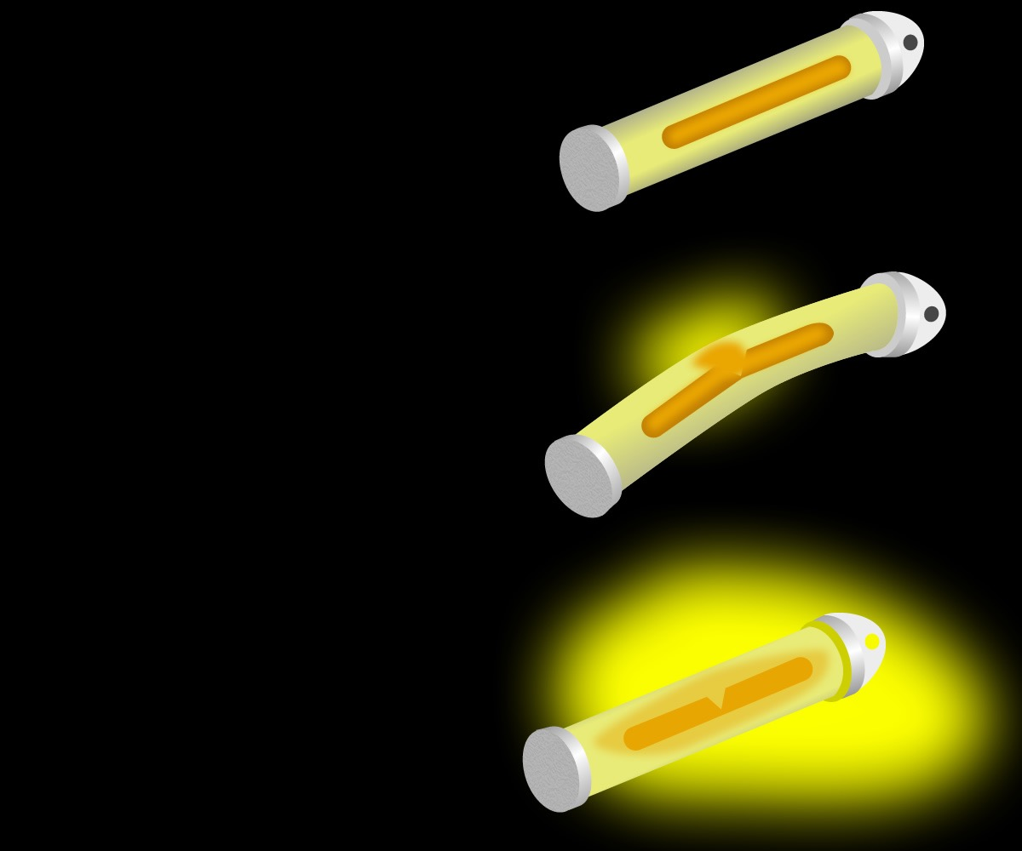
BEFORE
You will do an investigation to study the energy released in the glowstick reaction.
See how the glowstick reaction is affected by temperature.
Learn about the everyday uses of glowsticks.
What are the two reactants?
What is the purpose of the hydrogen peroxide solution in the drawing?
Glass Vial
Hydrogen Peroxide Solution
Phenyl Oxalate Ester and Fluorescent Dye Solution
Plaster Casing
AFTER

Slide 7
Are glowsticks reactions exothermic?
What type of energy is released?

Slide 8
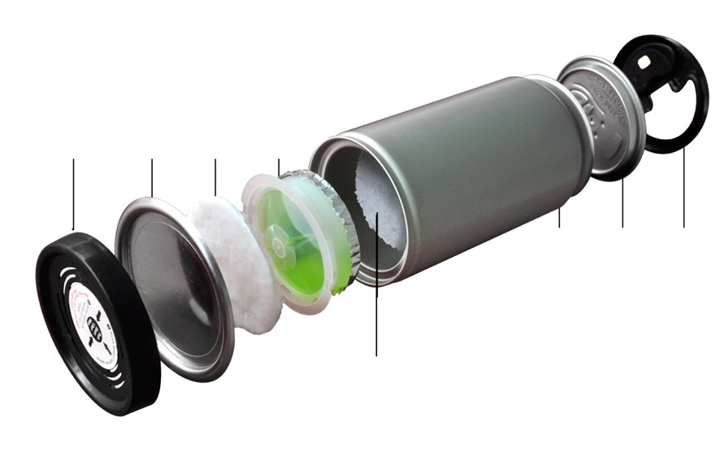
What are ‘Hot can’ used for?
Water cup attachment
Lower cover
Cotton pad
cover
Cover
Cover Lip
Bodyn (aluminium)
CaO (Quicklime)

Slide 9
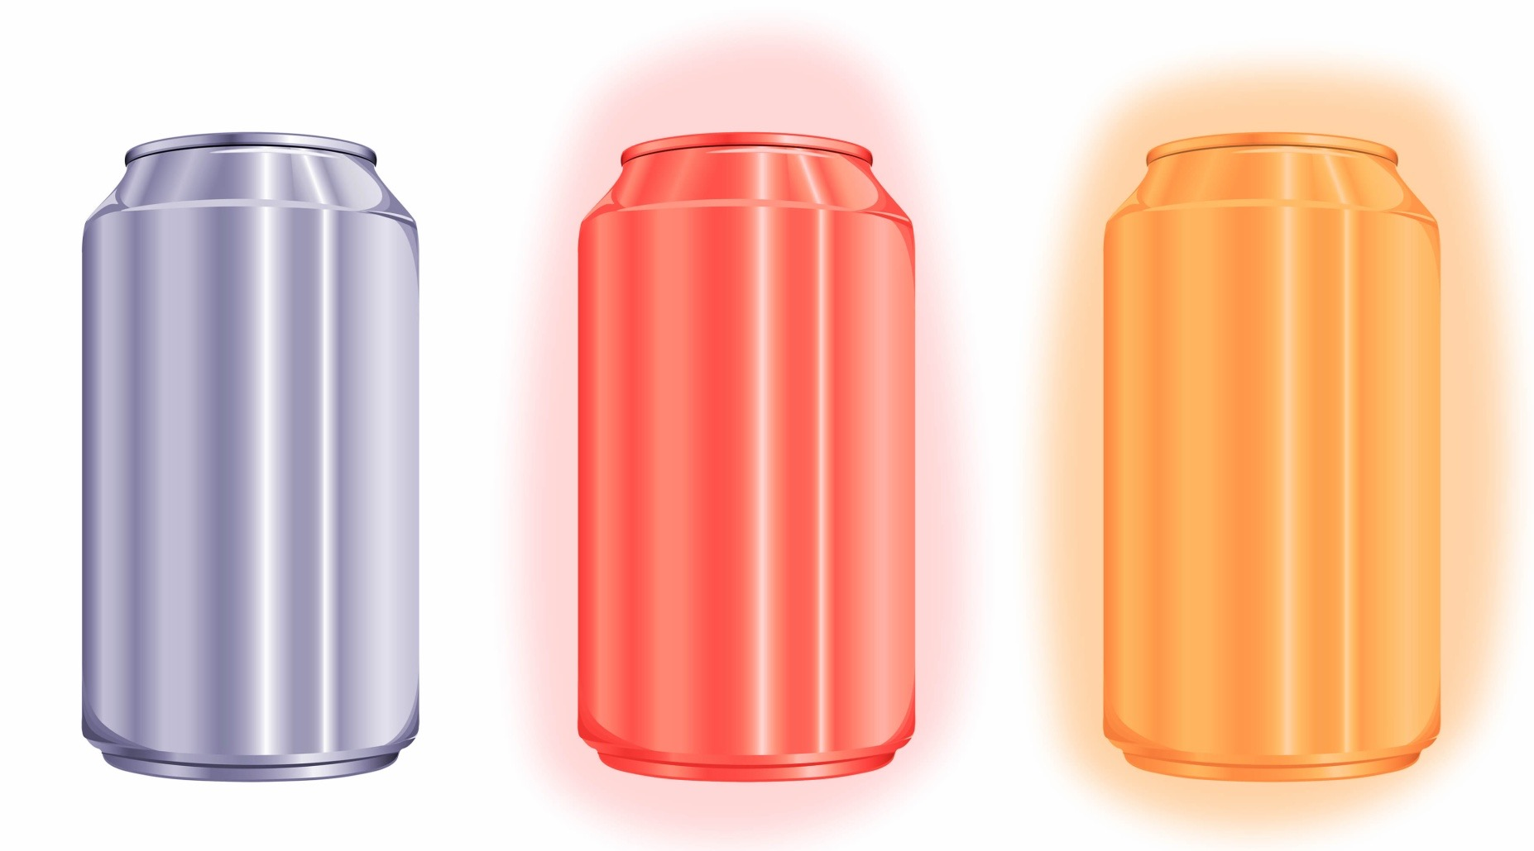
?
How effective is the ‘Hot Can’ reaction you studied in the lab?
1.3

