Slide 1
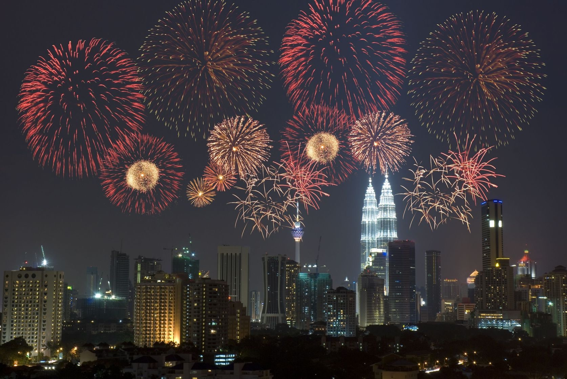
Chemical Change
Episode 2: Fireworks

Slide 2
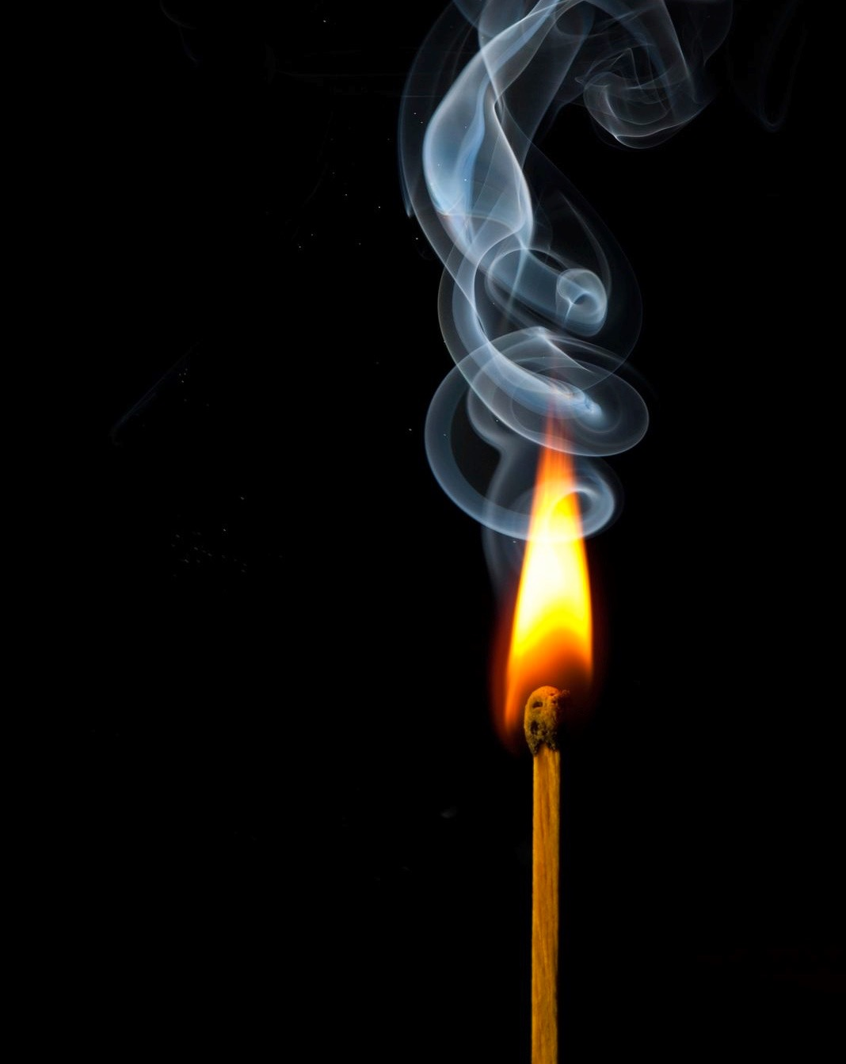
You will learn that:
burning needs oxygen.
fuels burn to release energy.
new substances are made in chemical reactions.
oxygen, fuel and heat are the three components of the Fire Safety Triangle.
fireworks contain their own oxygen supply.

Slide 3
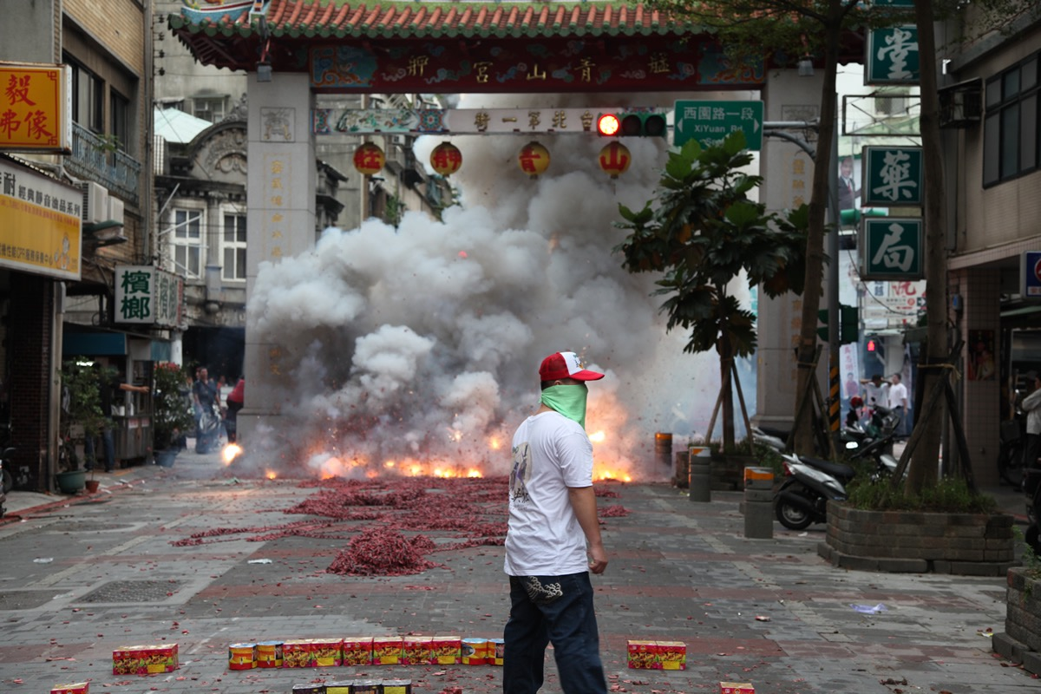
The Chinese invented fireworks over 1000 years ago.
2.1

Slide 4
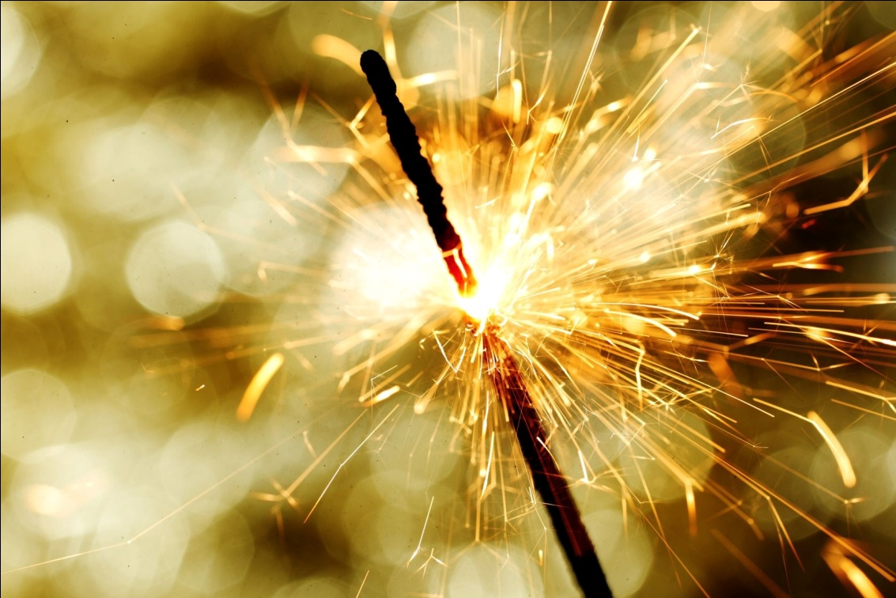
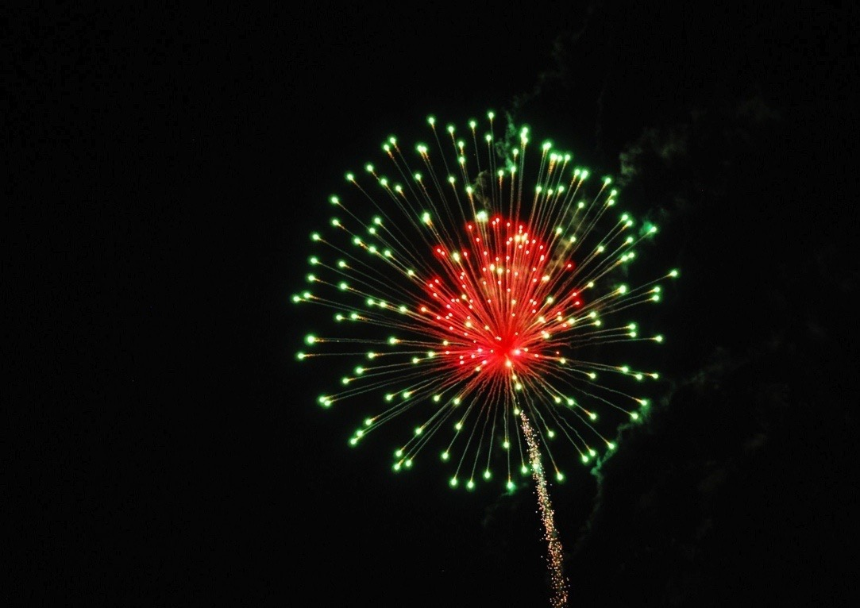
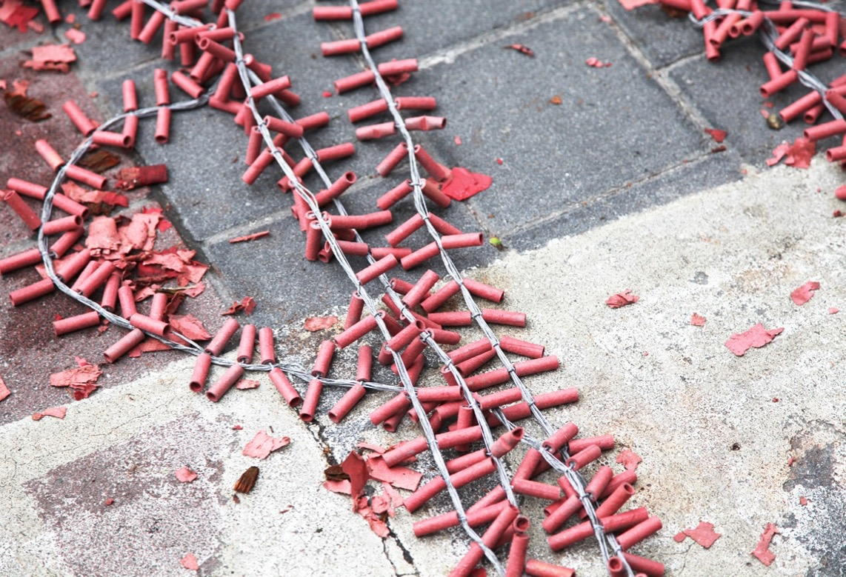
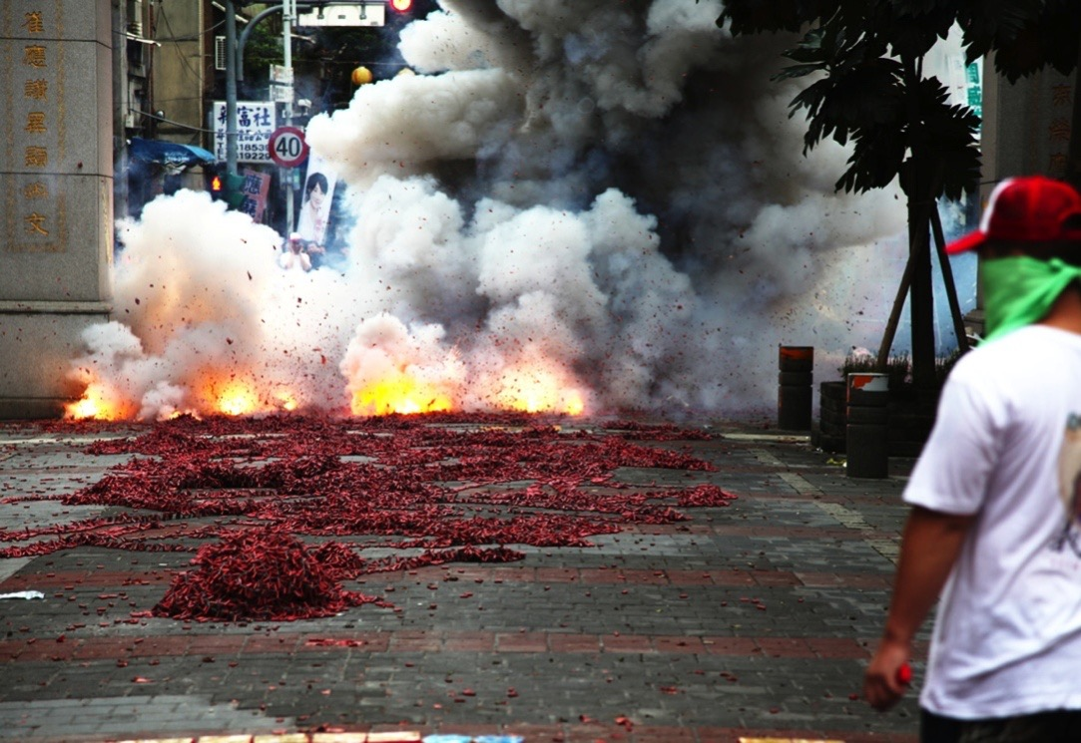
What are the three kinds of firework?

Slide 5
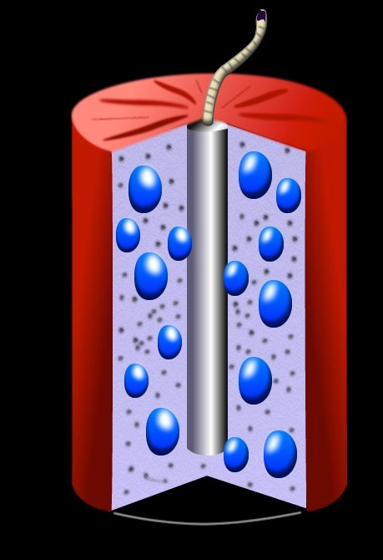
What do the three types of firework have in common?
What type of chemical reaction occurs when a firework is lit?
What forms of energy are released?
How does each firework work?
Bursting charge
Black Powder
Stars

Slide 6
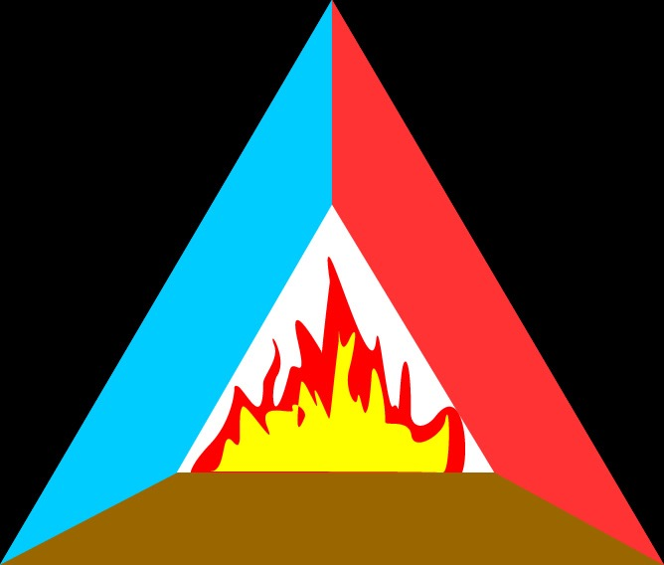
What is the Fire Triangle?
How does it help us to use fireworks safely and control fires?
Oxygen
Heat
Fire
Fuel

Slide 7
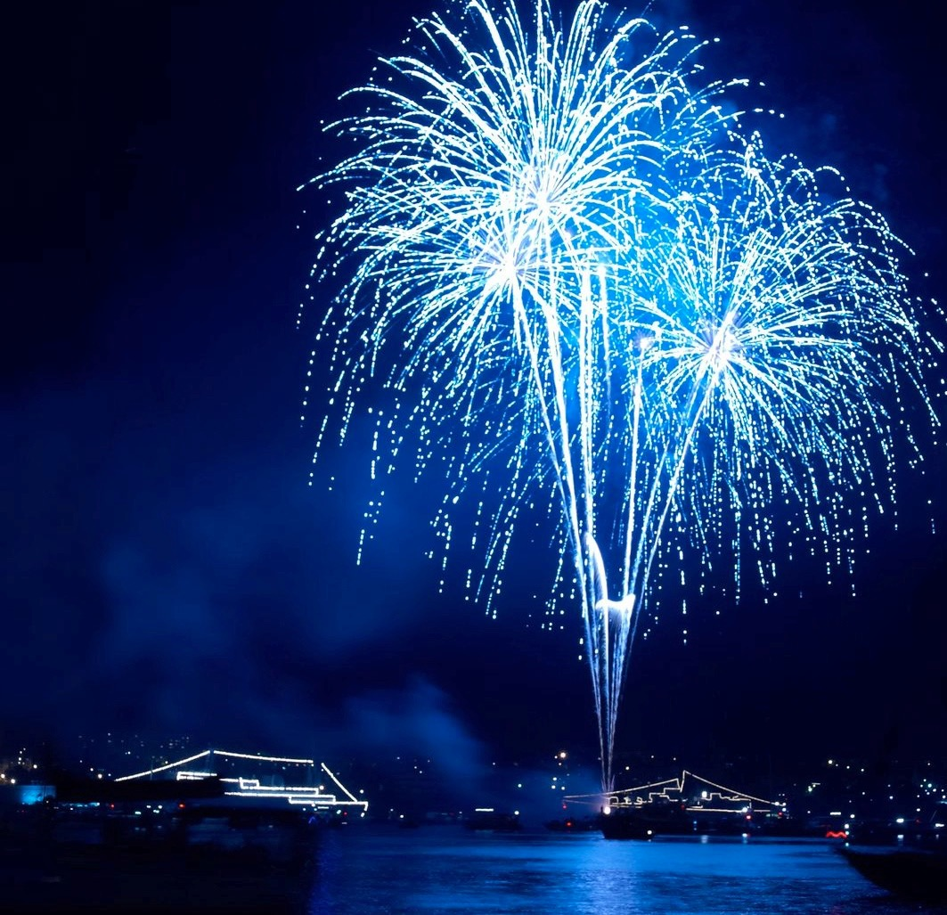
What have you learned about firework safety?
How pleased are you with your poster?
How could you have improved it?
Explain the basic chemistry of fireworks.
Explain how the Fire Safety Triangle can help you use fireworks more safely.

Slide 8
What should teachers and parents know about the chemical reactions that take place in fireworks?
Try to explain these reactions.
Can you explain how different colours are produced in a firework?
Will having a better understanding of fuels, burning and the importance of oxygen in fires help to make people more safety conscious? Explain why.

